Slide 1
Performance evaluation of a CRAN system
Gerardo alvaro
Francesco barbarulo
Francesco Fornaini

Slide 2






Description of the system
Case B – With compression
General view
Case A – No compression
s $=sOriginal ∗(1−\frac{C}{100})$
X bytes/s
Application Server
Baseband Unit
Cell
S $=C ∗$50 ms
Remote Radio Head

Slide 3

Model
RRH₁
μ_{rrh}
π₁
AS
BBU
RRH₂
λ_{bbu}
μ_{bbu}
π₂
μ_{rrh}
.
.
.
π_{N}
RRH_{N}
μ_{rrh}
T_{waiting_bbu}
$$\frac{s}{X}$$
T_{decompression}
T_{Delay}
+
+
T_{transmission}
+
T_{waiting_rrh}
=
Negligible
+
Negligible
+
C * 50 ms

Slide 4
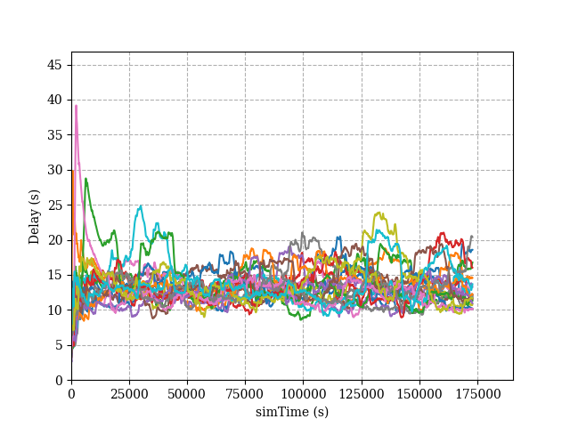
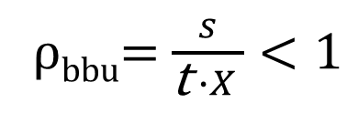
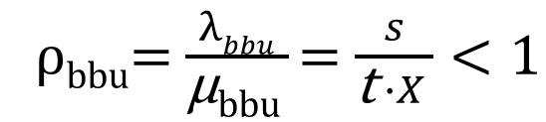
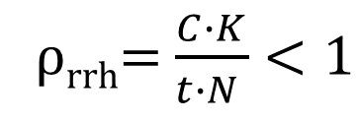
The simulator has been verified through Valgrind and known-results simulations.
For the warm-up study:
Stability Conditions:
Case A
ρ_{bbu}= $\frac{λbbu}{\text{μ}\text{bbu} }$= $\frac{s}{\text{t} ∙X }<1$
Case A
Case B
ρ_{bbu}= $\frac{s}{\text{t} ∙X }<1$
ρ_{rrh}= $\frac{C∙K}{t∙N }<1$

Slide 5
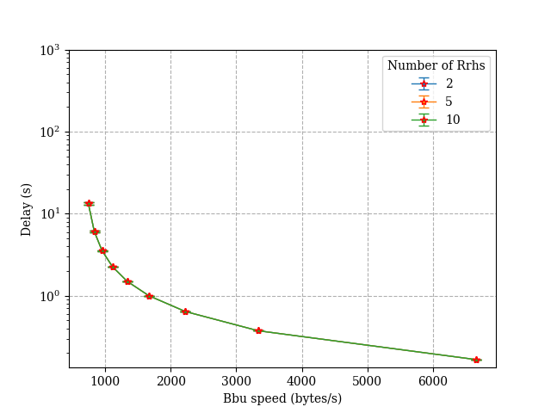
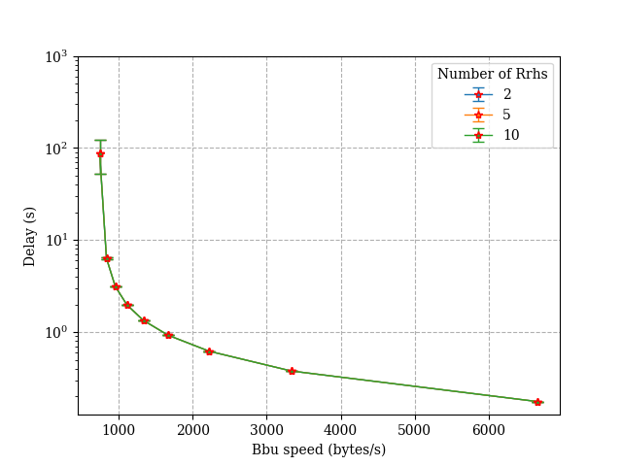
Case A
Factors:
N : number of RRH, with values of 2, 5 and 10.
X : transmission speed of the BBU, with values chosen accordingly with ρ_{bbu}
Exponential
Lognormal

Slide 6
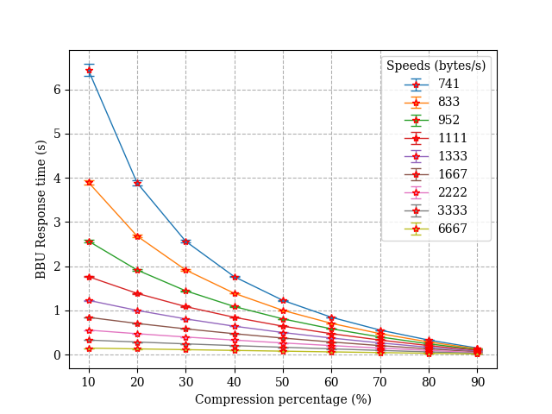
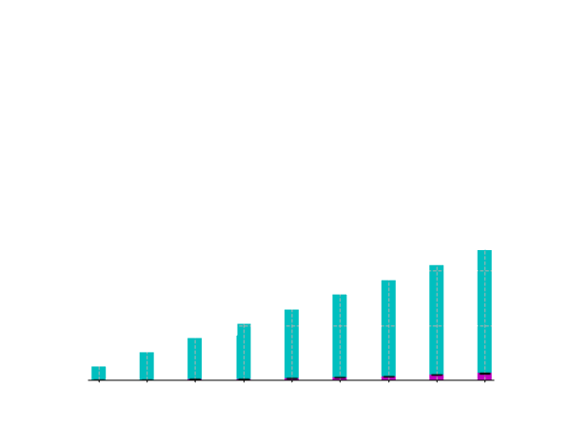
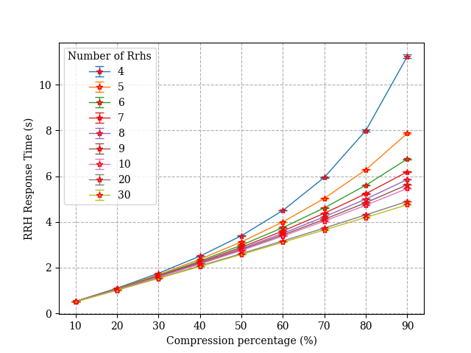
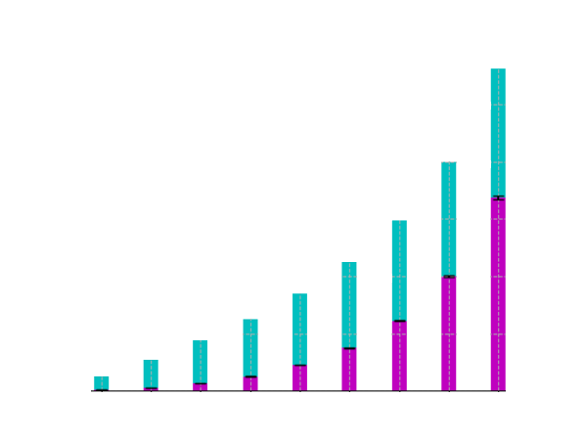
Case B - Exponential
By Burke’s theorem: E[R] = E[R]_{bbu} + E[R]_{rrh}
E[R]_{rrh} ratio with 30 RRH
E[R]_{rrh}
E[R]_{bbu}
E[R]_{rrh} ratio with 4 RRH

Slide 7
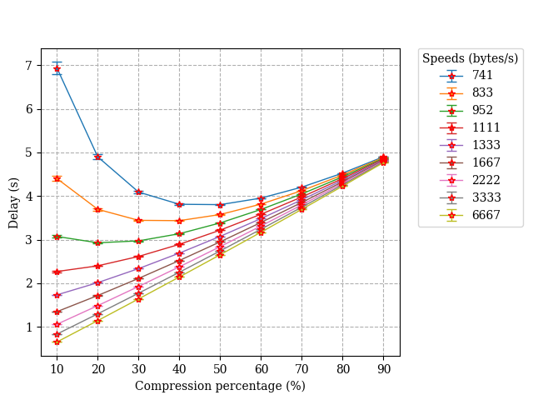
Case B - Exponential
Best scenario (N = 30)
?
No advantages
Always decreasing
E[R]_{rrh}

Slide 8
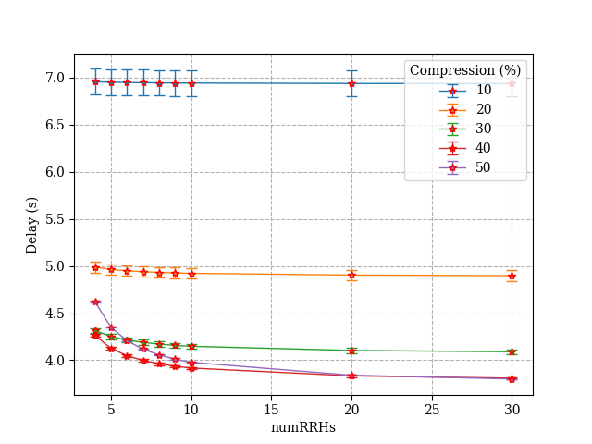
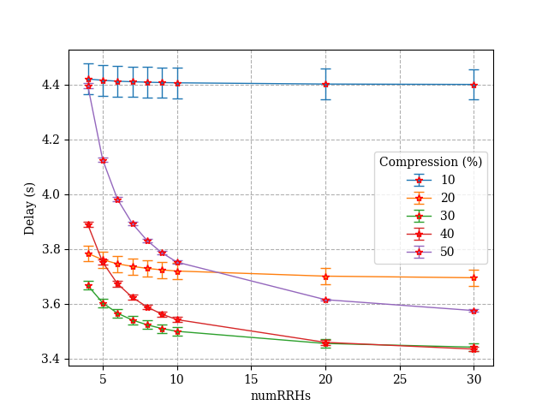
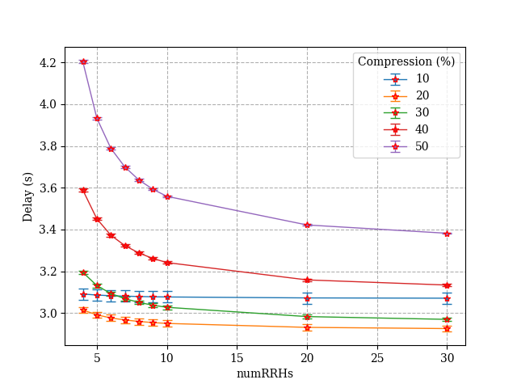
Case B - Exponential
741 bytes/s
833 bytes/s
952 bytes/s
>
30%
>
20%
40%

Slide 9
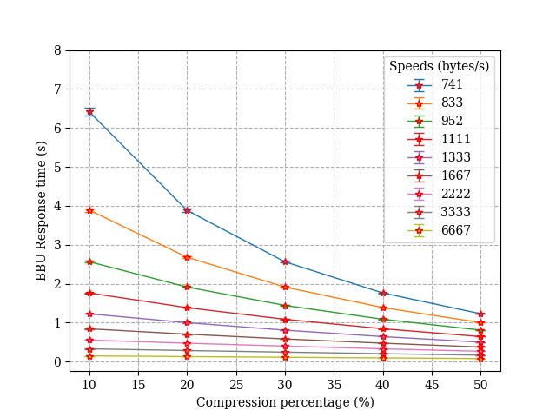
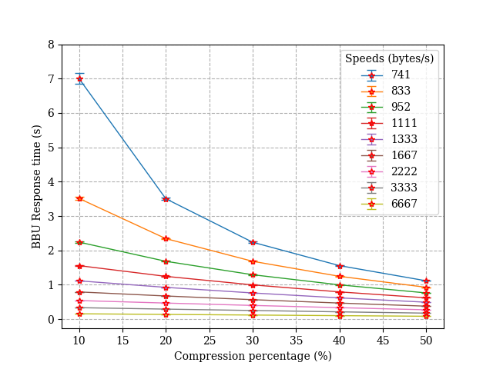
Case B - Lognormal
Exponential:
Lognormal:

Slide 10
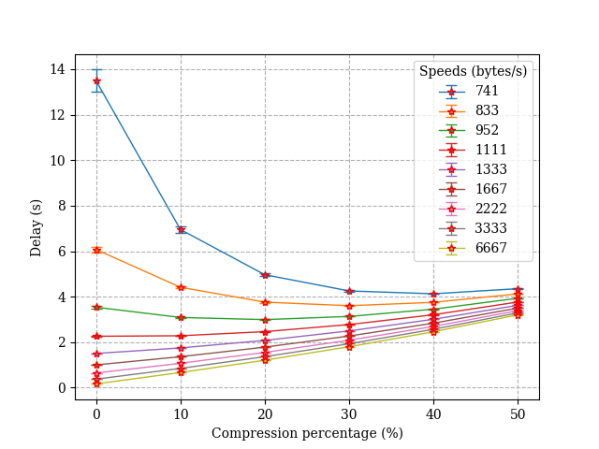
Comparison
Worst scenario (N = 4)
Always
?

Slide 11
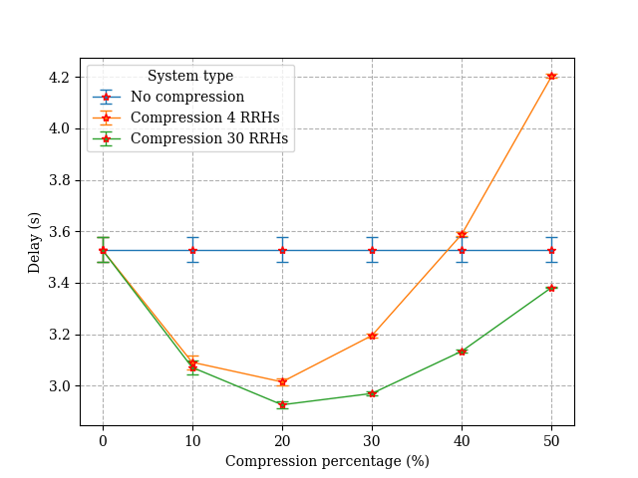
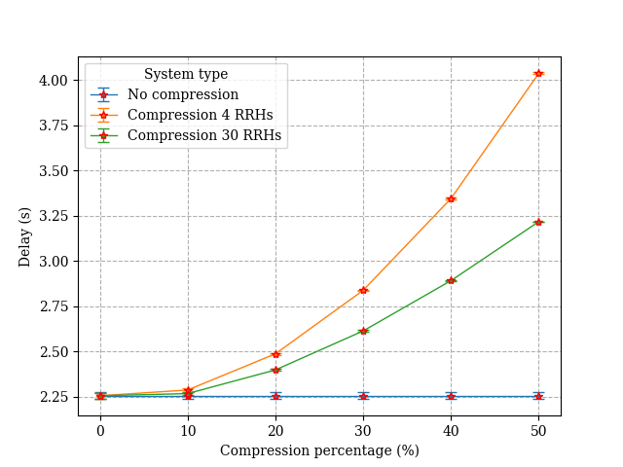
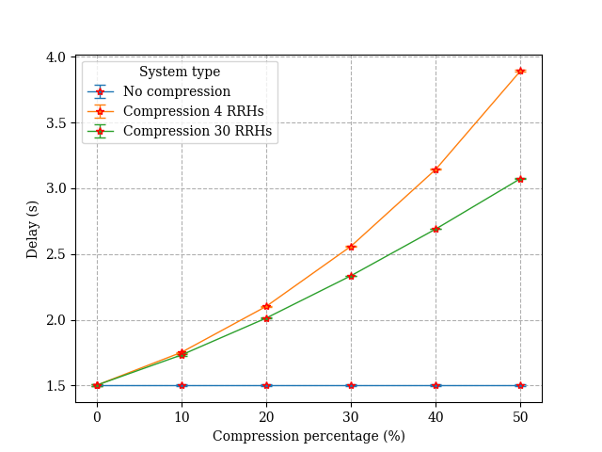
Comparison
952 bytes/s
1111 bytes/s
1333 bytes/s
Yes
?
No

Slide 12
Conclusions
The system perfoms better increasing X
Without compression
With compression
When compression is convenient?
The benefits can be appreciated only at slow BBU transmission speeds
High X: low compression regardless N
Low X: ideal compression value taking into account N

